Slide 1
Sequence 10 _ Break Even Analysis_Engineering Economics
Dr. Hassan Ashraf
Assistant Professor_ Civil Engineering Department _ CU Islamabad _ Wah Campus

Slide 2
Break Even Analysis
In general, “ Break-even analysis is the process of varying a parameter of a problem and determining what parameter value causes the performance measure to reach some threshold or “break-even” value.”
Break even point can be defined as a point where the costs (expenses) and total sales (revenue) are equal. Break even point can be described as a point where there is no net profit or loss.
It is pertinent to recall that increase in MARR value reduces the present worth of an asset to decrease. In a similar manner, the method of break even analysis across sufficient data points allows economists and analysts to find out the break even point besides providing information on other parameters of interest of interest such as the time taken to reach break even point, rate (slope) at which the break-even point is achieved.

Slide 3
Break Even Analysis
Another extremely point to remember is finding out the variable of interest with which the relationship of outcome variable is expected to be most sensitive. For example, in order to understand the aforementioned argument, lets consider that an investor wants to setup a plant that produces flexible European style garden chairs. The CEO of the investment company is interested in knowing the parameters/variables which could have a significant influence on the investment decision. He could possibly have a few variables to look into which could include MARR, volumes of sales, price per unit, and other parameters. Now, here the investor could perform variety of break-even analysis. One possible break-even analysis could relate to the value of MARR and Present worth. Another, break-even analysis could be related with the first cost or investment cost and the relation with present worth. Also, another possible break even point could relate to the savings in electricity costs and its influence on the present worth. Also, another break-even point could be related with the number of sales and the generated revenue.

Slide 4
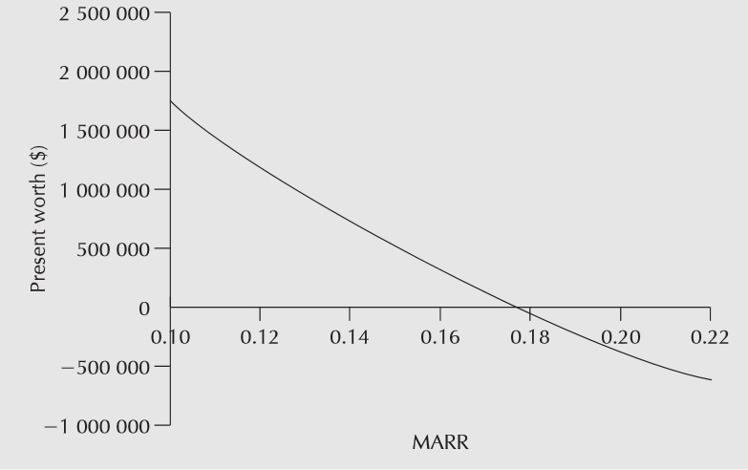
Break Even Chart for MARR

Slide 5
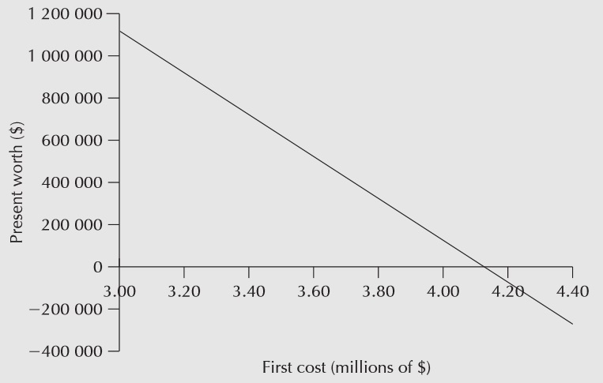
Break Even Chart for First Cost

Slide 6
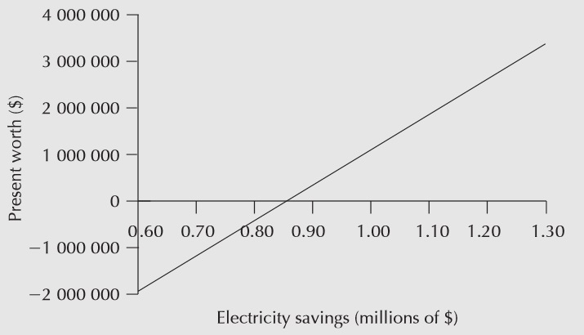
Break Even Chart for Electricity Savings

Slide 7
Thank You

